Slide 1

LINEAR ALGEBRA
SRI HARI DEGREE COLLEGE
(Permanently Affiliated to Yogi Vemana University, Kadapa)
Recognized by UGC New-Delhi under Section 2(f) &12(8)
An ISO 9001:2015Certified Institution
#45/290-10,BalajiNagar,Kadapa,A.P.,INDIA-516003
E-Mail:sriharidc047@gmail.com Web www.sriharidegreecollege.ac.in ©9440074132
prepared
by
DR.V.SUBBAREDDY (H.O.D)
Dept.of Mathematical Sciences

Slide 2
Eigen Values and Eigen vectors of a Matrix
Let
be a square matrix.
Let
be a column vector. Consider the vector equation AX = λX …………….. (1)
Where λ is a scalar. If ‘I’ demotes the unit matrix of order n,
then the above equation (1) can be written as AX = λI X
i.e (A - λI) X = 0 ………………. (2)
This matrix equation represents the following system of n homogeneous
equations in ‘n’ unknowns.

Slide 3
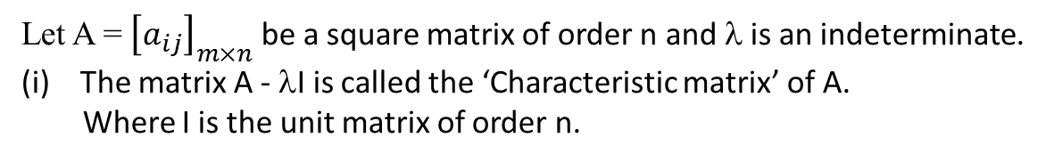
Here the coefficient matrix of this system is A - λI.
We know that the necessary and sufficient condition for the system (3) to
possess a non – zero solution is that the coefficient matrix A - λI is singular.
i.e. |A - λI| = 0
Now we have the following definitions:
1) Definitions:
Let A = ${\left[a_{ij}\right]}_{m×n}$ be a square matrix of order n and λ is an indeterminate.
The matrix A - λI is called the ‘Characteristic matrix’ of A.
Where I is the unit matrix of order n.

Slide 4
which is an ordinary polynomial in λ of degree n, is called the
Characteristic polynomial’ of A.
(iii) Now the equation |A - λ I| = 0 is called the characteristic equation of A and the roots of this equation are called the characteristic roots or Eigen values or Latent rots or proper values of the matrix A.
(iv) Characteristic vector or Eigen vector of a matrix:-
If λ is an equation value of the matrix A, then |A - λI| = 0 i.e the matrix A - λ I is singular.Therefore there exists a non – zero vector X such that (A - λI| = 0 or AX = λX is said to be the Eigen vector or Characteristic vector of A corresponding to the Eigen valueλ.

Slide 5
Properties of Eigen values of a matrix:-
i) The Eigen values of a diagonal matrix are its diagonal elements.
Proof:
The characteristic equation of A is |A - λI| = 0
On expanding, we have
⇒ λ = a₁₁, a₂₂, ….. a_{nn}

Slide 6
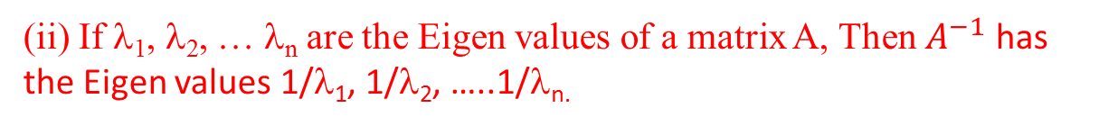
(ii) If λ₁, λ₂, … λ_{n} are the Eigen values of a matrix A, Then $A^{−1}$ has the Eigen values 1/λ₁, 1/λ₂, …..1/λ_{n.}
Proof:-
Let λ_{r} be the Eigen value of a matrix A and X_{r} be its corresponding
Eigen vector. Then by the definition, we have AX_{­r} = λ_{r} X_{r} ……… (1)
Pre – Multiplying both sides of (1) by A⁻¹ ; we obtain

Slide 7


This shows that $\frac{1}{λ_{r}}$ is the Eigen values of A⁻¹ .
Also the above result is true for r = 1, 2 …n
Hence the Eigen values of A⁻¹ are $\frac{1}{λ_{1}},$ $\frac{1}{λ_{2}},\frac{1}{λ_{3}},…..\frac{1}{λ_{n}}$
3. If λ is an Eigen value of A, then λ^{m} is an Eigen value of A^{m}; where m is any positive integer:
Proof:
Let λ be the Eigen value of matrix A and X be its corresponding Eigen vector. Then by the definition, we have AX = λX ………… (1)
we have A(AX) = A (λX)
i.e A²X = λ² X …………. (2)

Slide 8
λ²is the Eigen value of A²
Again pre – multiplying equation (2) by A, we have
A(A²X) = A (λ² X)
A³X = λ² (AX)
= λ² (λX)
i.e A³X = λ³X
λ³ is the Eigen value of A³
So on proceeding in the same process, we can show that λ^{m} is the Eigen
Value of A^{m}; where m is positive integer.
4. The sum of the Eigen values of a matrix A is equal to the trace of A.
Proof:
We shall prove this property by considering a square matrix of order 3.

Slide 9
λ be its eigen value
Now the characteristic polynomial of A is
……(i)
If λ₁ , λ₂ ,λ₃ are the eigen values of A, then
|A - λI|= (-1)³(λ-λ₁)( λ-λ₂)( λ-λ₃)…………………….(ii)
Equating the RHS of (i) and (ii) and comparing the coefficients of A²,we have

Slide 10
λ₁ + λ₂ + λ₃ = a₁₁ + a₂₂ + a₃₃
i.e The sum of the Eigen values of A = The sum of the element of the principal diagonal of A.
Hence the sum of Eigen values of a matrix A is equal to the trace of the matrix A.
5. The product of the Eigen values of a matrix is equal to its determinant.
Proof :
Let λ₁, λ₂,…. λ_{n} be the eigen values of a matrix A.
Then |A - λI| = (-1)^{n} (λ - λ₁) (λ - λ₂) …. (λ - λ_{n}) … (1)
Taking λ = 0 in (1); we have
|A| = (-1)^{n} (0 - λ₁) (0 - λ₂)…. (0 - λ_{n})
= (-1)^{2n}. λ₁. λ₂ ….λ_{n}

Slide 11
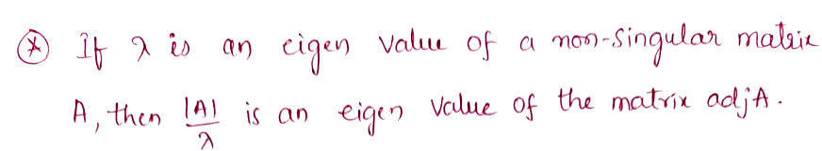
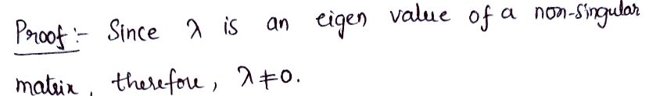
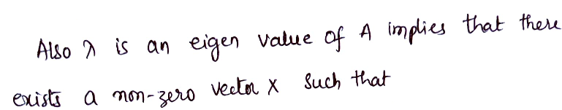

i.e The determent of A = The product of the Eigen values of A.
Hence the product of the Eigen values of A is equal to its determinant.

Slide 12
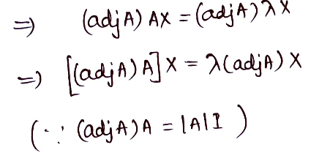
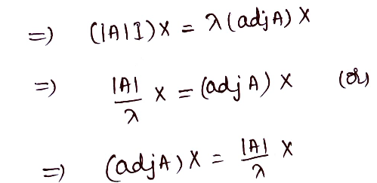
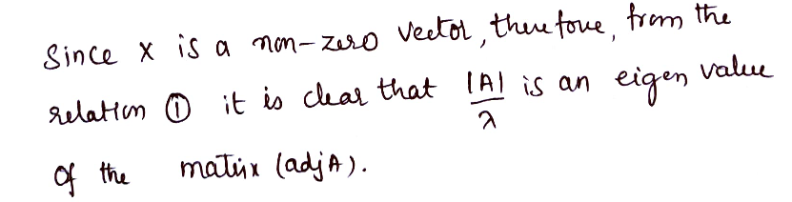

Slide 13
Solved Examples
1. Find the Eigen values and Eigen vectors of the matrix
Sol.:
The characteristic equation of A is ⏐A - λI⏐ = 0
Expanding by R₁ we have - λ³ - λ² + 21λ + 45 = 0
i.e. λ³ + λ² - 21λ - 45 = 0
i.e., (λ + 3) (λ² – 2λ - 15) = 0
i.e., (λ + 3) (λ + 3) (λ - 5) = 0
i.e., λ = -3, -3, 5
Thus the Eigen values of A are λ = -3, -3, 5

Slide 14
For λ = - 3 ; the system (i) can be written as
R₂ → R₂ – 2R₁ ; R₃ → R₃ + R₁ we have

Slide 15
Here the coefficient matrix of the system is of rank 1 i.e., r = 1. So that the given system has n – r = 3 – 1 = 2 linearly independent solutions.
i.e., There are two linearly independent Eigen vectors corresponding to the Eigen value λ = -3
To determine these; from the above system
The equation can be written as
x₁ + 2x₂ + 3x₃ = 0 …………… (1)
Taking x₂ = 0 ; we have x₁ + 3x₃ = 0
Let us take x₁ = -3 and x₃ = 1

Slide 16
is the linearly independent Eigen vector of A corresponding to λ= -3
Taking x₃ = 0; we have x₁ + 2x₂ = 0
Let us take x₁ = -2 ; x₂ = 1
is the another linearly independent Eigen vector of A corresponding to the same Eigen value λ = -3
For λ = 5 ; the system (i) can be written as

Slide 17
R₂ → 7R₂ + 2R₁ ; R₃ → 7R₃ – R₁ we have
R₃ → R₃ – R₂ we have
Here the coefficient matrix of the system is of rank 2.
i.e., r = 2. So that the given system has n – r = 3 – 2 = 1 linearly independent solution.
i.e., There is only one linearly independent Eigen vector corresponding to the Eigen value λ = 5.

Slide 18
To determine this; from the above system, the equations can be written as
-7x₁ + 2x₂ – 3x₃ = 0 …….(2)
x₂ + 2x₃ = 0 …….(3)
From (3); x₂ = -2x₃ ⇒
Let us take x₂ = -2 and x₃ = 1
From (2); - 7x₁ = -2x₂ + 3x₃ = 4 + 3 = 7
i.e., x₁ = -1
is the linearly independent Eigen vector corresponding to λ = 5.

Slide 19

2. Find the Eigen values and the Eigen vectors of the matrix
Sol.:
Expanding by $R_{1}\text{we} \text{get}$

Slide 20
∴ The Eigen values of A are λ= 0, 3, 15.

Slide 21
For λ = 0 ; from equation (i) the system can be written as
R₂ → 4R² + 3R₁ ; R₃ → 4R₃ – R₁ , we have
R₃ → R₃ + R₂ ; we have

Slide 22
Here the coefficient matrix of system is of rank 2
i.e., r = 2. So that the system has n - r = 3 – 2 = 1 linearly independent solution.
i.e., There is only one linearly independent Eigen vector corresponding to λ = 0
To determine this; from the above system,
the equations can be written as
8x₁ – 6x₂ + 2x₃ = 0 …………..… (1)
10x₂ – 10x₃ = 0 …………..… (2)
From (2) ; 10x₂ = 10x₃ ⇒ x₂ = x₃
Let us take x₂ = 1 and x₃ =1
From (1) ; 8x₁ = 6x₂ – 2x₃ = 6 – 2 = 4
i.e., x₁ = ½

Slide 23
For λ = 3; the system (i) can be written as
R₂ → 5R₂ + 6R ; R₃ → 5R₃ – 2R₁ ; we have
R₂ → 2R₃ – R₂ ; we have

Slide 24
Here the coefficient matrix of system is of rank 2
i.e., r = 2. So that the system has n - r = 3 – 2 = 1 linearly independent solution.
i.e., There is only one linearly independent Eigen vector corresponding to λ = 3
To determine this ; from the above system,
the equations can be written as
5x₁ – 6x₂ + 2x₃ = 0 …………..… (3)
-16x₂ – 8x₃ = 0 …………..… (4)
From (4); -16x₂ = 8x₃

Slide 25
Let us take x₂ = 1; x₃ = – 2
From (3); 5x₁ = 6x₂ – 2x₃ = 6 + 4 = 10
i.e. x₁ = 2
is the linearly independent Eigen vector corresponding to λ = -3.
For λ = 15 ; the system (i) can be written as
R₂ → 7R₂ – 6R₁ ; R₃ → 7R₃ + 2R₁ , we have

Slide 26
R₃ → R₃ – 2R₂ ,we have
Here the coefficient matrix of system is of rank 2
i.e., r = 2. So that the system has n - r = 3 – 2 = 1 linearly independent solution.
i.e., There is only one linearly independent Eigen vector corresponding to λ = 15
To determine this; from the above system, the equation can be written as
− 7x₁ – 6x₂ + 2x₃ = 0 …………..… (5)
− 20x₂ – 40x₃ = 0 …………..… (6)
From (6); − 20x₂ = 40x₃

Slide 27
Let us take x₂ = -2 and x₃ = 1
From (5) – 7x₁ = 6x₂ – 2x₃ = -12 – 2 = -14
i.e. x₁ = 2
is the only linearly independent Eigen vector corresponding to λ = 15.
3. Find the Eigen values and the Eigen vectors of a matrix
Sol.:
The characteristic equation of A is |A - λI| = 0

Slide 28
Expanding by R₁, we have
= - 2 satisfy the equation. So λ + 2 is one factor
By synthetic division; we have

Slide 29
(λ +2) (λ - 3) (λ - 6) = 0
∴ λ = - 2, 3, 6
Thus the Eigen values of A are λ = - 2, 3, 6
Now the Eigen vectors X corresponding to the Eigen value λ are obtained by solving the system of equations (A - λ I) X = 0.
For λ = - 2; from (i), we have

Slide 30
R₂ → 3R₂– R₁; R₃ → R₃ – R₁;we have
Here the rank of the coefficient matrix of the system is r = 2. So that the system has n – r = 3 – 2 = 1 linearly independent solution. i.e There is only one linearly independent Eigen vector corresponding to the Eigen value λ = - 2.
To determine this; from the above system, the equations can be written as
3x₁ + x₂ + 3x₃ = 0 ……………. (1)
20x₂ = 0 ……………. (2)
from (2) ; x₂ = 0
from (1) ;3x₁ + 3x₃ = 0

Slide 31
is the only linearly independent Eigen vector
corresponding toλ = -2.
For λ = 3 ; from (i), we have
R₂ → 2R₂ + R₁ ; R₃ → 2R₃ + 3R₁ , we have
R₃ → R₃ – R₂ , we have

Slide 32
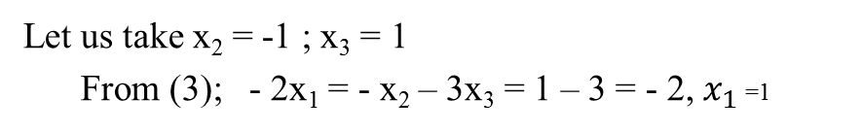
Here the rank of the coefficient matrix of the system is r = 2. So that the given
system has n– r = 3 – 2 = 1 linearly independent solution.
i.e., There is only one linearly independent Eigen vector corresponding to the
Eigen value λ = 3. To determine this; from the above system the equations can be written as
- 2x₁ + x₂ + 3x₃ = 0 ………(3)
5x₂ + 5x₃ = 0 ……..(4)
from (4); 5x₁ = - 5x₃
Let us take x₂ = -1 ; x₃ = 1
From (3); - 2x₁ = - x₂ – 3x₃ = 1 – 3 = - 2, $x_{1}$ =1

Slide 33
is the linearly independent Eigen vector corresponding to λ = 3.
For λ = 6; from equation (1), we have

Slide 34
Here the coefficient matrix of the system is of rank r = 2. So that the system has n-r = 3-2=1 linearly independent solution.
i.e. There is only are linearly independent Eigen vector corresponding to λ = 6.
To determine this; from the above system the equations can be written as

Slide 35
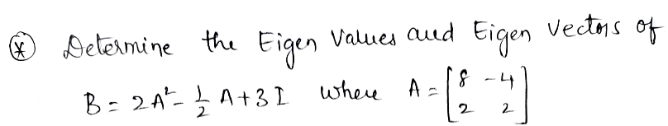

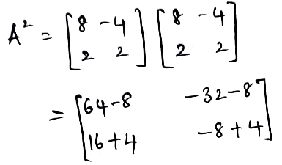
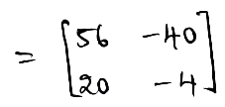
is the only linearly independent Eigen vector corresponding to λ = 6.

Slide 36

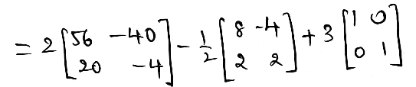
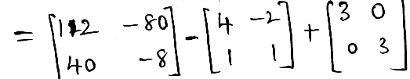
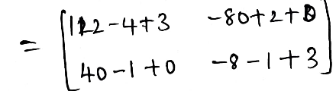
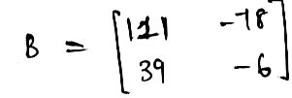

Slide 37

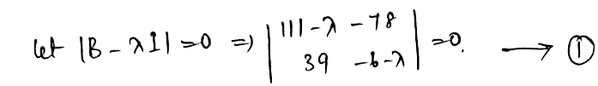
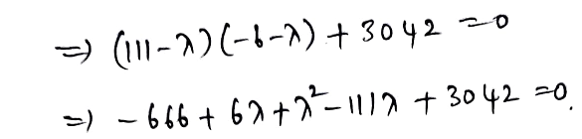
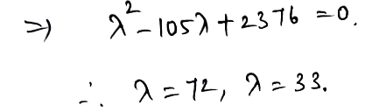

Slide 38



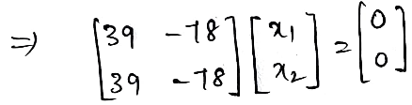
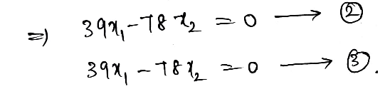

Slide 39
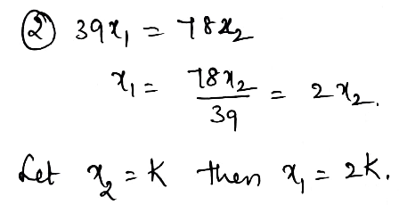
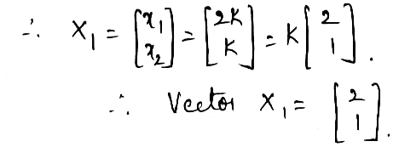


Slide 40
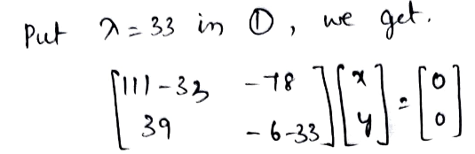
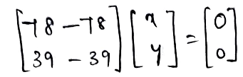
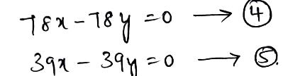

Slide 41
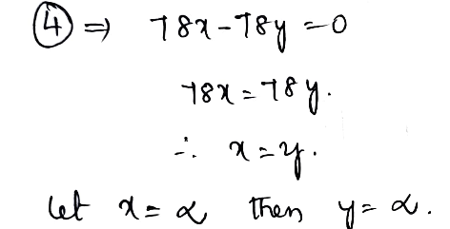
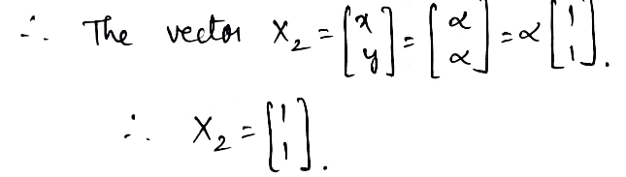
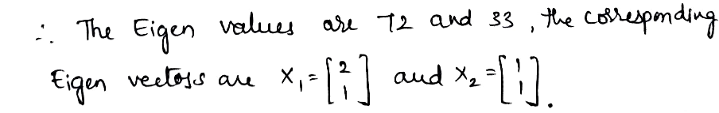

Slide 42
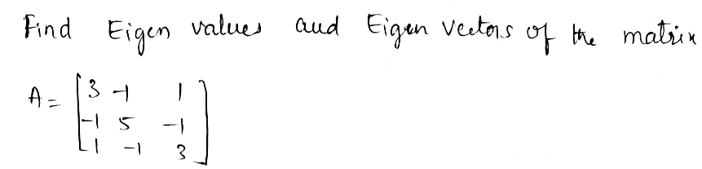
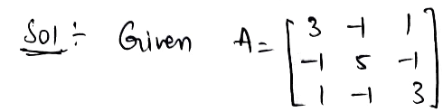
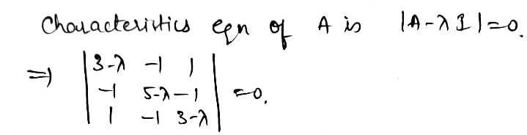

Slide 43
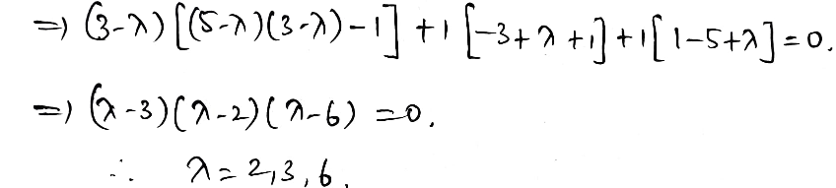

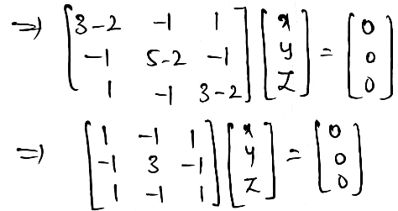

Slide 44
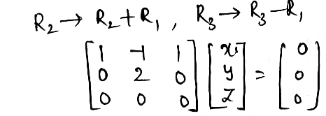

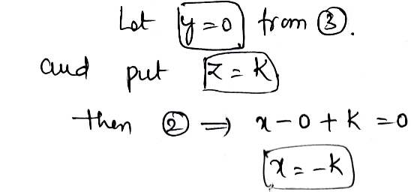

Slide 45
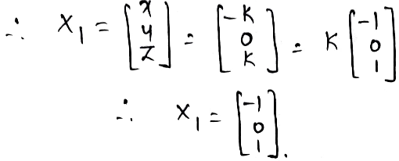

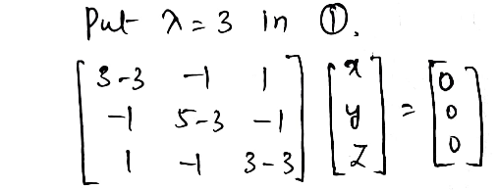

Slide 46
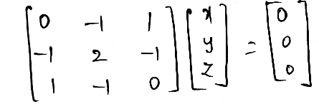
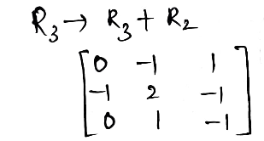
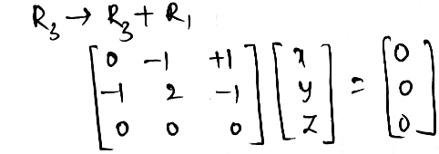

Slide 47
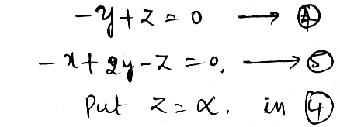
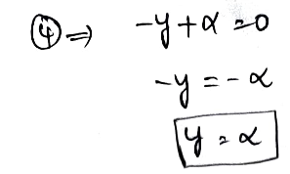
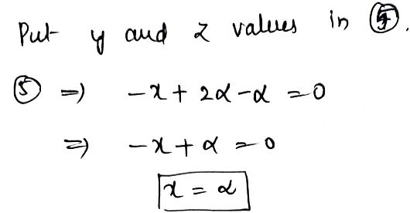

Slide 48
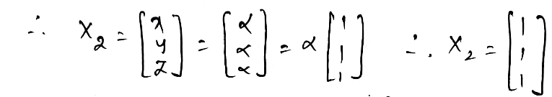

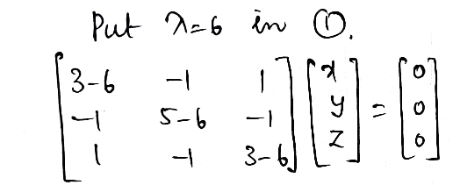
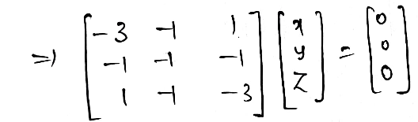

Slide 49
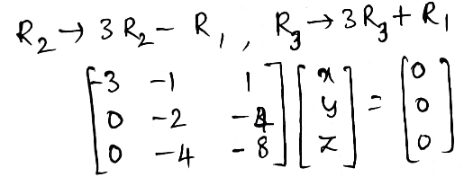
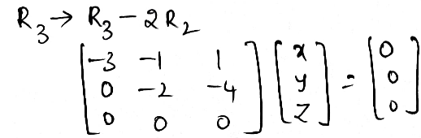
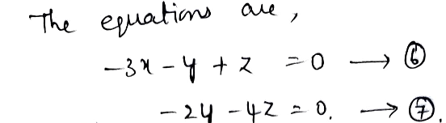

Slide 50



Slide 51



Slide 52





Slide 53





Slide 54



Slide 55





Slide 56




Slide 57





Slide 58



Slide 59


Slide 60
CALYEY – HAMILTON THEOREM
Matrix Polynomial:
An expression of the F(λ) = A₀+A₁λ + A₂λ² + …. + A_{m}λ^{m} , A_{m} ≠ 0, where A₀, A₁, A₂, ….A_{m}
are square matrices of same order over a field F, is called a “matric polynomial” of degree m.
The symbol λ is called indeterminate.
The matrices themselves are matric polynomial of zero degree.
Note: 1) Two matric polynomials equal if and only if the coefficients of like powers of λ are the same.
2) The degree of the product of two matri polynomials is less than or equal to the sum of their degree.
Cayley – Hamilton theorem:
Every square matrix satisfies its own characteristic equation
i.e., If for a square matrix A of order n,
⏐A - λI⏐ = (-1)^{n} [λ^{n} + a₁λ^{n-1} + a₂λ^{n-2}+ …..+ a_{n}], then the matrix equation
x^{n} + a₁x^{n-1} + a₂x^{n-2}+….+a_{n}I=0 is satisfied by X = A i.e.,
A^{n} + a₁A^{n-1} + a₂A^{n-2} + ….. + a_{n}I = 0

Slide 61
Determination of $A^{−1} \text{by} \text{Cayley}\text{ – }\text{Hamilton} \text{theorem}\text{:}$
Pre-multiplying equation (i) by A⁻¹ on both sides; we have
A⁻¹ [A^{n} + a₁A^{n-1} + a₂A^{n-2} + …………+ a_{n}I] = 0
A^{n-1} + a₁A^{n-2} + a₁A^{n-3} + …….. + a_{n-1}I + a_{n}A⁻¹ = 0
a_{n}A⁻¹ = - [A^{n-1} + a₁A^{n-2} + ……. + a_{n-1}I]
If m be a positive integer such that m ≥ n, then multiplying the equation (i) by A^{m-n} we get
A^{m} + a₁A^{m-1} + ……….. + a_{n} A^{m-n} = 0.
Which shows that any positive integral power A^{m}(m ≥ n) of A is linearly expressible in terms it’s lower order.

Slide 62




Slide 63




Slide 64




Slide 65



Slide 66





Slide 67





Slide 68





Slide 69

prepared by
DR.V.SUBBAREDDY (H.O.D)
Dept.of Mathematical Sciences

